Slide 1

Python! Day 14
Snake game day 1

Slide 2
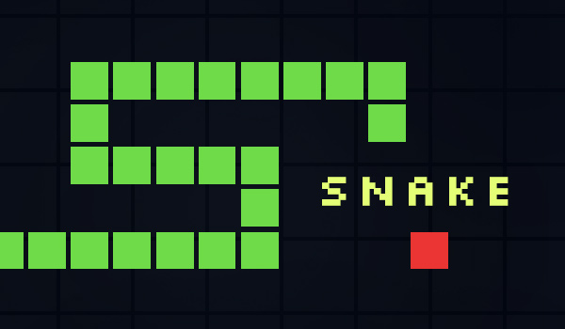
Multi-Day Project: Snake Game
For the next couple of classes, we are going to be using Turtle to create a polished and playable video game
We’ll be creating a version of the snake game
This will be a long project which will use many of the skills we’ve learned in Object Oriented Programming and the turtle module
Let’s start this project by opening up a new Python project folder for it

Slide 3
Snake Game Steps
Create a snake body
Move the snake
Create snake food
Detect collisions with the food
Create a scoreboard
Detect collisions with the wall
Detect collisions with the tail

Slide 4
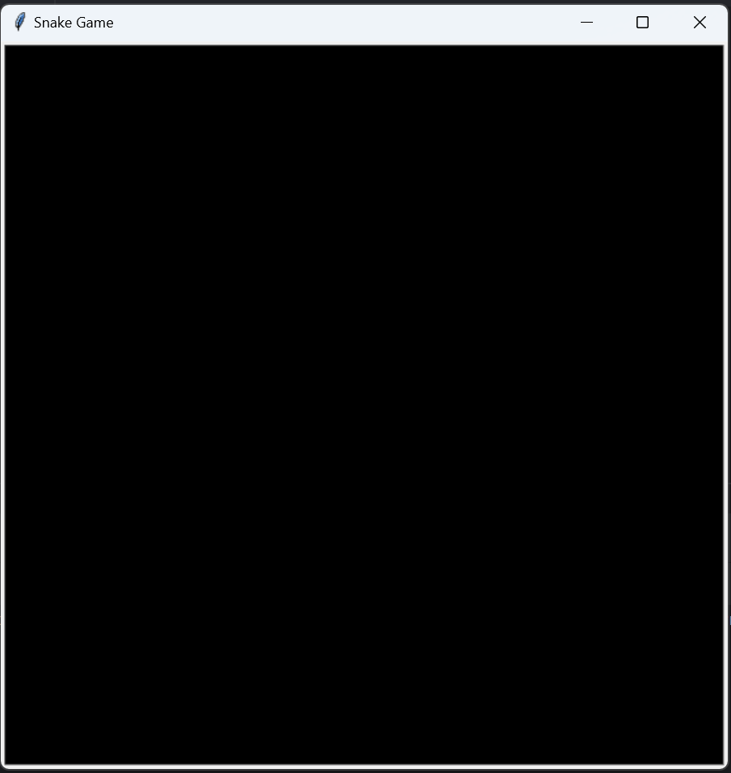
Setting Up the Screen
Let’s begin our project by setting up a 600 x 600 screen with a black background
from turtle import Turtle, Screen
s = Screen()
s.setup(600, 600)
s.bgcolor("black")
s.title("Snake Game")
s.exitonclick()

Slide 5
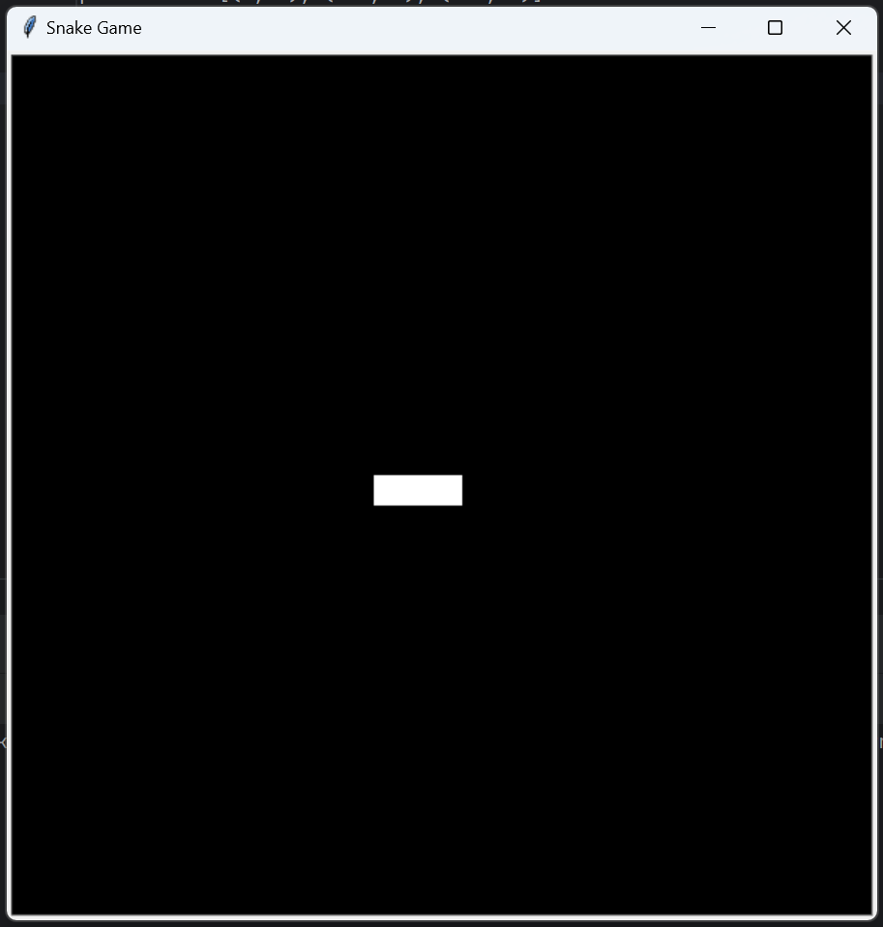
Create a Snake Body
To create the snake’s body, we’ll create 3 turtle objects that are 20 x 20 white squares lined up next to each other
We can do this using a for loop and assign their positions using a list:
positions = [(0, 0), (-20, 0), (-40, 0)]
Segments = []
for position in positions:
new_segment = Turtle(“square”)
new_segment.color(“white”)
new_segment.penup()
new_segment.goto(position)
segments.append(new_segment)

Slide 6
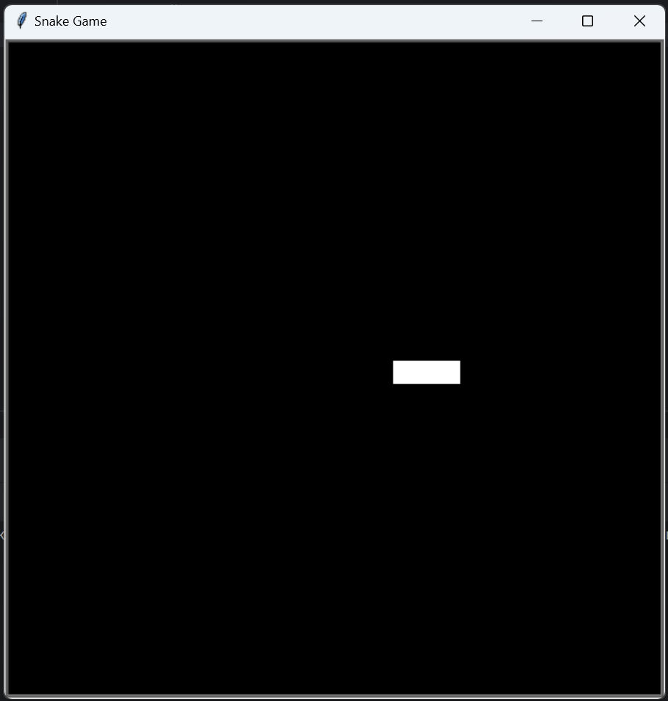
Move the Snake
The next step is to make the snake move continuously forward
To start, let’s create a while loop that individually moves each snake segment forward by 20
game_is_active = true
while game_is_active:
for seg in segments:
seg.forward(20)
Notice that if we play this, the snake crawls like a caterpillar instead of moving smoothly like a snake

Slide 7
To fix this problem, first, let’s figure out what the problem is
To do this, let’s import Python’s time module and edit our code so there is a 1-second delay between the movement of each segment
import time
while game_is_active:
for seg in segments:
seg.forward(20)
time.sleep(1)
Now we can see that the issue with our snake is that each piece moves one by one

Slide 8
To fix this, we will have to control when the screen updates, so the snake only moves forward once all the segments have moved
To do this, at the beginning of our program, we’ll write:
s.tracer(0)
This stops automatically updating the screen, so we can now manually control when the screen updates using the update() method
Whenever we write s.update(), the screen will update
Now, let’s change our code to update the screen manually:

Slide 9
for pos in positions:
segment = Turtle("square")
segment.color("white")
segment.penup()
segment.goto(pos)
segments.append(segment)
s.update()
game_is_active = True
while game_is_active:
s.update()
time.sleep(0.1)
for seg in segments:
seg.forward(20)
s.exitonclick()

Slide 10
Now, there’s actually still an issue with the snake’s movement
This issue becomes obvious if we try to turn the snake
If we try to turn the first segment of the snake, the snake’s head turns like it should, but its body continues moving forward
To fix this, we’ll have to change how the segments of the snake move
Instead of moving all of the segments forward by 20, let’s move each segment to the position of the segment in front of it and only move the head of the snake by 20
Now, if the snake turns, the body will follow the head of the snake

Slide 11
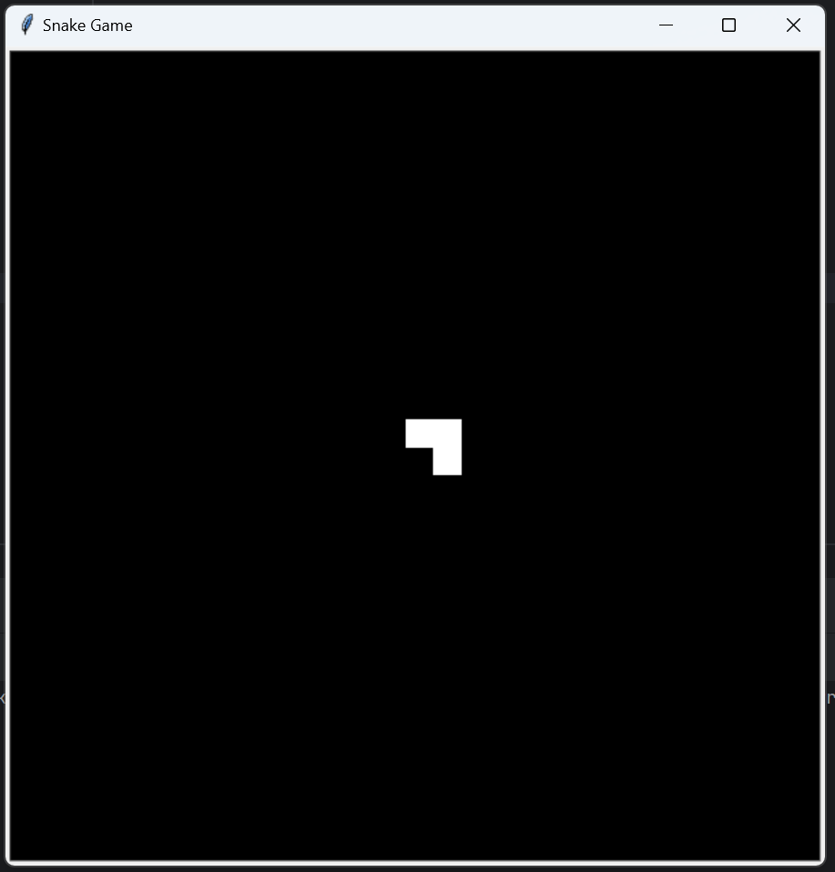
To do this, we can write a for loop that starts with the last segment in the list and moves it to the position of the segments in front of it
We’ll need to write a loop that counts backward, like this:
s.update()
time.sleep(0.1)
for n in range (len(segments) - 1, 0, -1):
x_pos = segments[n – 1].xcor()
y_pos = segments[n – 1].ycor()
segments[n].goto(x_pos, y_pos)
segments[0].forward(20)

Slide 12
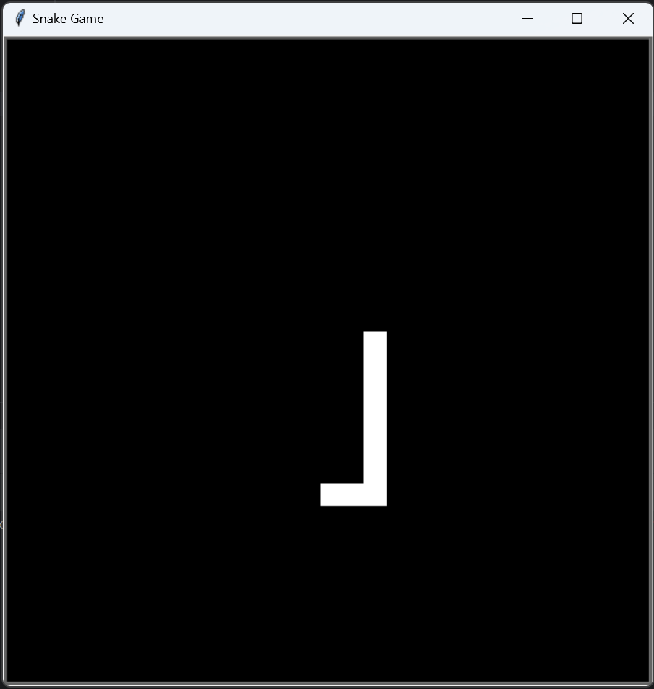
To finish up the snake’s movement, let’s let the player turn and control the snake
To do this, let’s start by using the onkeypress() method:
s.listen()
s.onkeypress(go_up, "Up")
s.onkeypress(go_down, "Down")
s.onkeypress(go_left, "Left")
s.onkeypress(go_right, "Right")
Now we need to write the go_up, go_down, go_left, and go_right functions

Slide 13
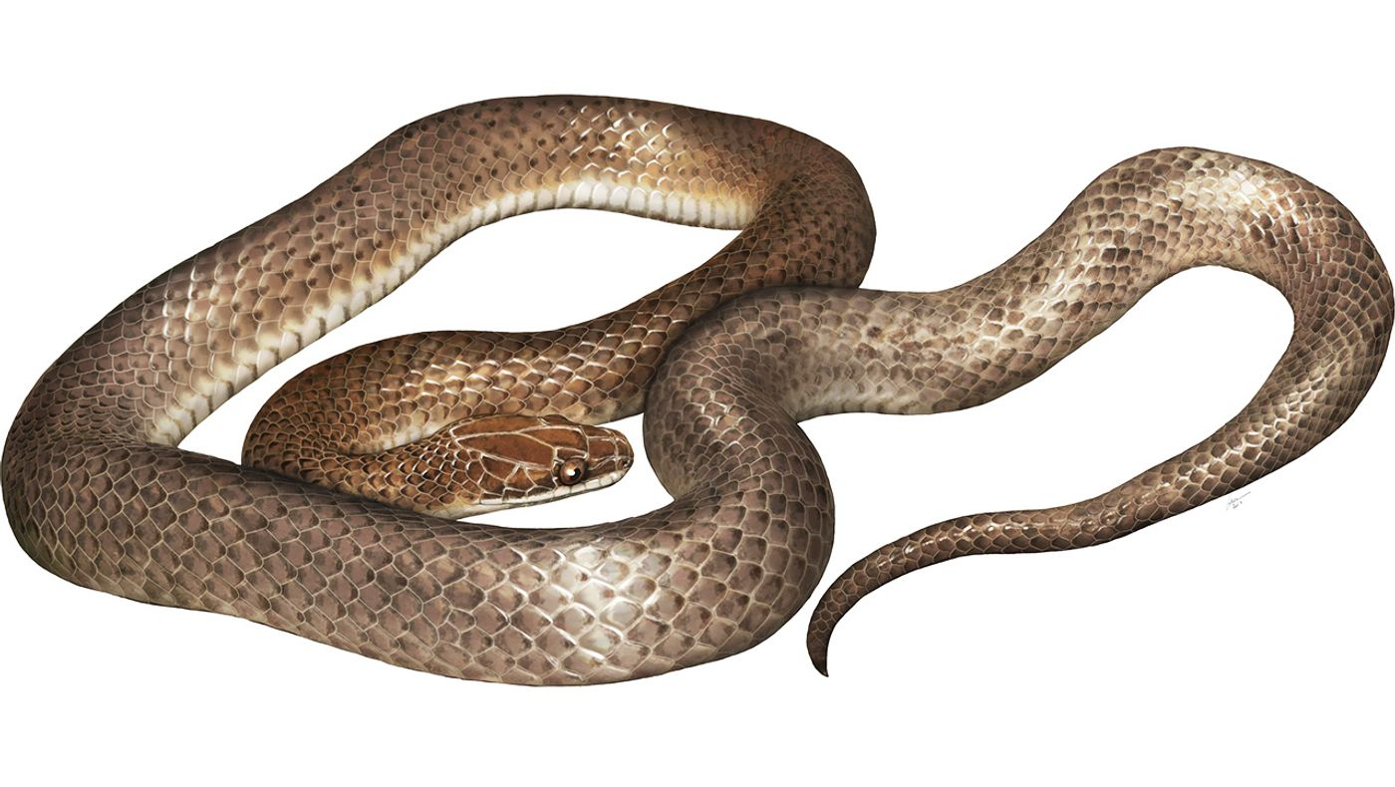
For these functions, we can use the setheading() function of the turtle to set the turtle’s direction to left/right/up/down without having to calculate how much to use left() or right()
t.setheading(0) = right
t.setheading(180) = left
t.setheading(90) = up
t.setheading(270) = down
Note that we don’t want to be able to turn the snake in the direction opposite of where it’s facing
For example, if the snake is facing right, it can’t go left
This is because then the snake would overlap with itself and cause problems

Slide 14
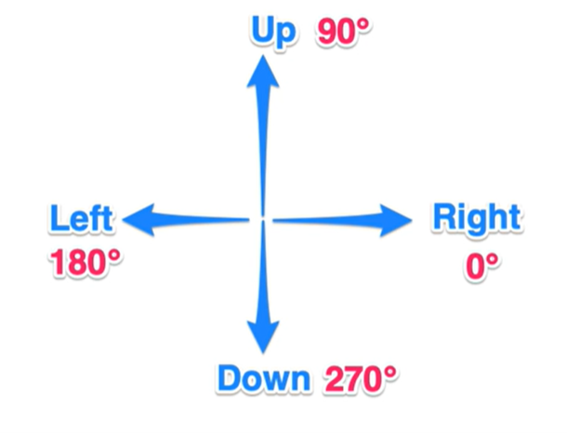
def go_up():
if segments[0].heading() != 270:
segments[0].setheading(90)
def go_down():
if segments[0].heading() != 90:
segments[0].setheading(270)
def go_right():
if segments[0].heading() != 180:
segments[0].setheading(0)
def go_left():
if segments[0].heading() != 0:
segments[0].setheading(180)

Slide 15
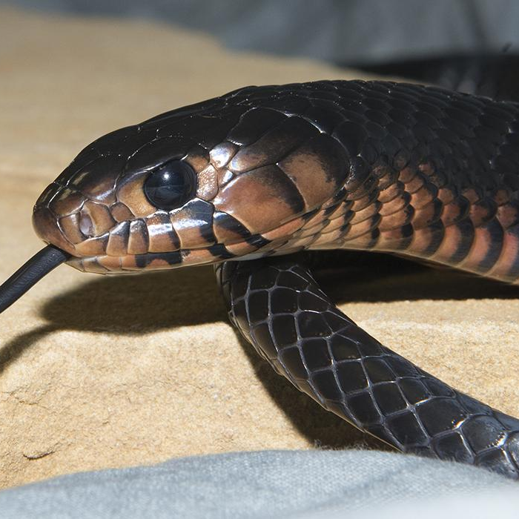
Making a Snake Object
Next, let’s clean up our code by creating and using a snake object
Let’s move anything that has to do with the snake into a snake class and replace it in our main file
At the end of this project, we will have 3 classes: the Snake class, the Food class, and the Scoreboard class

Slide 16
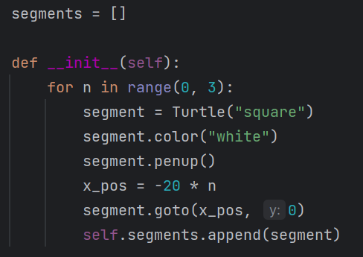
Init Function
When we create an object where we want something to happen once the object is created, we can create an __init__ function
Whatever is in the init function will happen once the object is created or initiated
In this case, we can put the code creating the snake segments in the init function

Slide 17
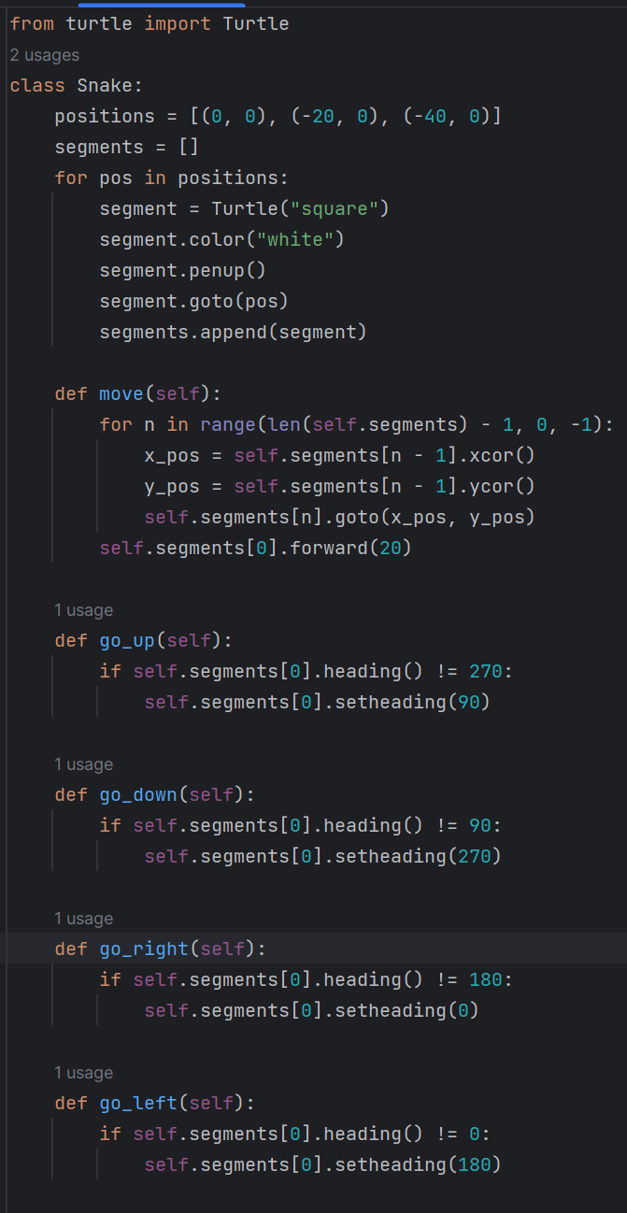
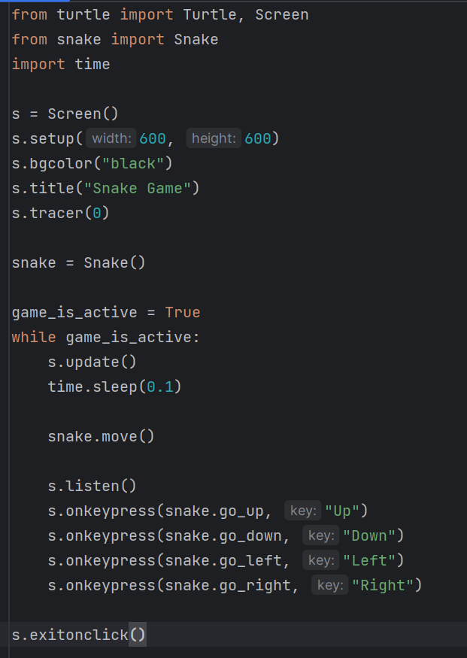

Slide 18
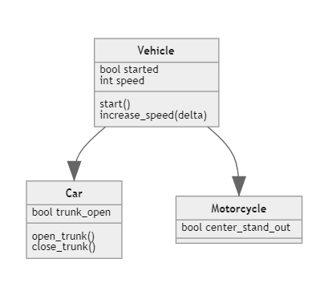
Class Inheritance
To continue our project, we’ll need to learn to do something a little complicated – to create food and stuff, we’ll need to edit parts of the turtle class
To do this, we can use something called “class inheritance.”
Class inheritance is when a “child” class inherits all the attributes and abilities of a “parent class.”
For example, let’s say we create a class called “Chef,” which has the functions stir(), cook(), and prepare(). Now we need to make a “pastry chef” class.

Slide 19
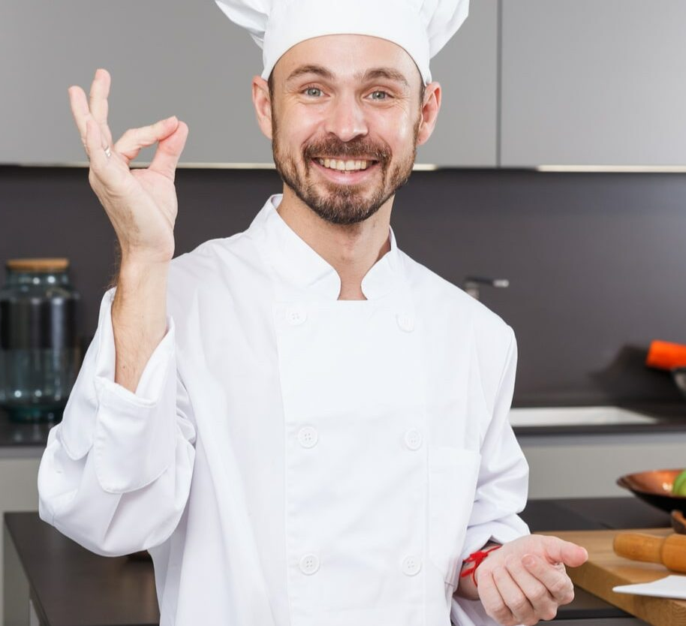
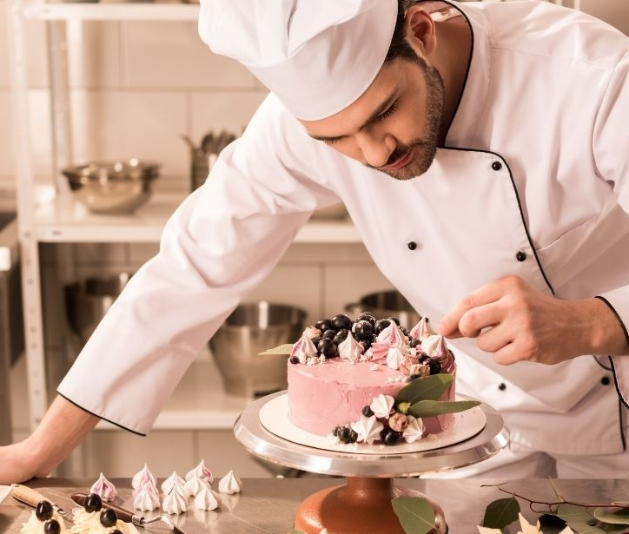
The pastry chef should be able to do everything the chef can, plus a couple of extra things, so we would want the pastry chef to inherit the chef’s stir(), cook(), and prepare() functions, and then we can add bake() and beat_egg() functions
In this case, the Chef would be the “parent” class, and the Pastry Chef would be the “child” class
We can create a child class like this:
class Chef:
# Chef behaviors and attributes
class Pastry_Chef(Chef):
def __init__(self):
super().__init__()
# Pastry chef-specific behaviors and attributes

Slide 20
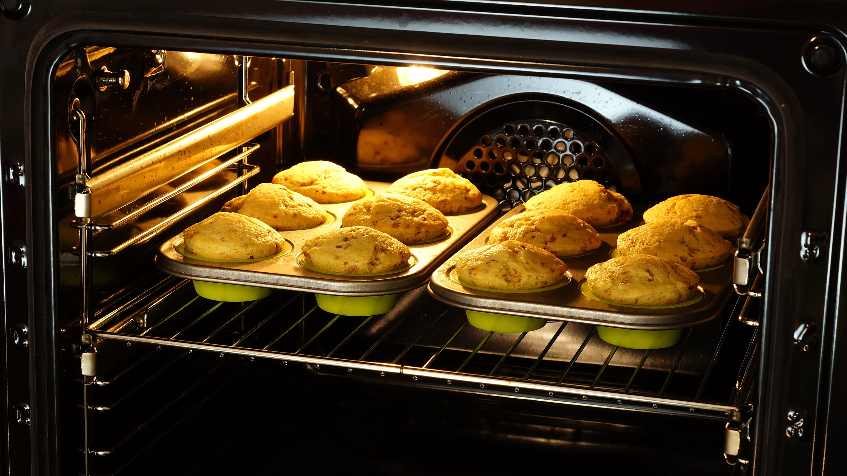
Another thing we can do with class inheritance is add to the existing methods of the parent class
Let’s say that in the pastry chef’s version of the cook() method, we want to print “in the oven” at the end
We can do that like this:
class Pastry_Chef(Chef):
def __init__(self):
super().__init__()
def cook(self):
super().cook()
print(“in the oven”)

